Slide 1

Topic Name – Information Technology Name – Suchana Ghosh Batch Code – ANU-D6152

Slide 2
1. Introduction to IT and Business Systems

Slide 3
Introduction
IT improves productivity, efficiency, and innovation in businesses.
It helps in communication, data storage, security, and remote connectivity.
IT makes work faster, easier, and more convenient.
Employees can focus more on innovation because many tasks are automated.
Digital transformation in organizations depends on IT support.
IT helps in data analysis and better decision-making.
Industries like healthcare, banking, and transportation rely heavily on IT.
The demand for IT professionals is growing rapidly worldwide.

Slide 4
Why is Information Technology important?
Helps employees complete work faster
Reduces manual work through automation
Enables emails, video calls, and online meetings
Supports remote work and connectivity
Stores large amounts of information safely
Protects data using passwords, antivirus, and security systems
Helps manage daily business activities smoothly
Improves accuracy and efficiency in work

Slide 5
Core functions of information technology
IT Governance
Aligns IT with business goals
Helps in proper budgeting and resource management
Ensures IT projects support company objectives
Focuses on risk management and policy creation
IT Operations
Manages daily IT activities
Uses automation to monitor systems and networks
Helps in troubleshooting, updates, and remote support
Saves time, cost, and resources

Slide 6
Hardware vs. software
Hardware
Hardware refers to physical computer devices and equipment.
Examples include computers, servers, printers, keyboards, and storage devices.
Hardware is necessary for processing and storing data
Software
Software refers to programs and applications used on computers.
It helps users perform tasks and manage systems.
Types include system software and application software

Slide 7
The Role of Information Technology in Modern Business
Improved Efficiency and Productivity
IT helps automate daily tasks
Reduces manual work and errors
Enhanced Communication
IT makes communication faster and easier
Tools like email, chat, and video calls improve teamwork
Data Management and Analysis
IT helps collect and store large amounts of data
Data analysis helps businesses make better decisions

Slide 8
Security and Risk Management
IT protects data and systems from cyber attacks
Uses firewalls, encryption, and antivirus tools
Keeps customer information safe
Helps maintain trust and company reputation
Cost Reduction
IT reduces manual work and operational costs
Automation saves time and money
Cloud computing reduces hardware expenses
Improves overall business efficiency

Slide 9
Supply Chain Management
IT plays a crucial role in optimizing supply chain operations. Through the use of sophisticated software, businesses can track inventory levels, manage logistics, and improve demand forecasting.
This ensures timely deliveries, reduces costs, and enhances overall supply chain efficiency.

Slide 10
What Is Enterprise Resource Planning (ERP)?
Enterprise Resource Planning (ERP) integrates and manages a company's core business processes to streamline operations and improve communication across departments.
ERP software integrates core business functions such as finance, operations, and human resources into a single system.
Many ERP systems are cloud-based, allowing remote access and real-time data sharing.
Benefits include improved efficiency, better data visibility, and streamlined reporting.
ERP solutions are highly customizable but require careful implementation.

Slide 11
How Enterprise Resource Planning Platforms Work
Modern ERP systems are cloud-based and can be accessed remotely They provide real-time data across the organization
Companies use ERP through subscription or service models
Different business applications are connected in one platform
All department data is stored in a central server Authorized users can access information instantly
ERP generates reports, charts, and graphs for business analysis
Helps track company performance and improve decision-making

Slide 12
ERP vs. CRM
ERP
Focuses on internal business operations
Manages resources and processes
Used by finance, HR, and operations teams
Improves operational efficiency
CRM
Focuses on customer relationships
Manages customer interactions and sales
Used by sales and marketing teams
Improves customer satisfaction and engagement

Slide 13
What Is Business Strategy, IT Strategy & Alignment Capability
Business Strategy
Business strategy is a long-term plan used to achieve business goals and competitive advantage.
It focuses on growth, profitability, customer satisfaction, and market success.
IT Strategy
IT strategy is a plan for using technology to support business operations and goals.
It helps organizations improve efficiency, communication, security, and innovation.
Alignment Capability
Alignment capability is the ability of an organization to coordinate business strategy and IT strategy effectively.
It ensures technology supports business objectives and organizational needs.

Slide 14
Importance of Business-IT Alignment
Improves business performance
Enhances communication between departments
Supports innovation and growth
Improves decision-making
Creates competitive advantage

Slide 15
Relationship Between Business and IT Strategy
Business strategy defines organizational goals.
IT strategy supports these goals using technology solutions.
Strong coordination between business and IT improves organizational success.
Poor alignment can reduce efficiency and increase risks

Slide 16
Benefits
Better operational efficiency
Faster decision-making
Improved productivity
Better customer service
Increased flexibility and innovation

Slide 17
Challenges
Communication gaps between business and IT teams
Rapid technological changes
Lack of clear goals and requirements
Resistance to change
Poor understanding of business needs

Slide 18
2. Data Types, Sources, and Lifecycle

Slide 19
Introduction
Structured Data Definition
Structured Data is organized data stored in rows and columns, making it easy to store, search, and analyze.
Semi-Structured Data Definition
Semi-Structured Data is partially organized data that does not follow a fixed table format but contains tags or labels for identification.
Unstructured Data Definition
Unstructured Data is data without a predefined format or structure, making it difficult to store and analyze in traditional databases.

Slide 20
Differences between Structured, Semi-structured and Unstructured data
Properties | Structured data | Semi-structured data | Unstructured data
Format | Organized | Partially organized | No fixed format
Schema | Fixed schema | Flexible schema | No schema
Flexibility | Low | Medium | High
Analysis | Easy | Moderate | Difficult

Slide 21
Common Data Sources
Internal Data
Internal data is the data collected from within an organization through its daily business operations and processes. It includes operational, machine-generated, and customer engagement data
External data
External data can include almost anything – from historical demographic data to market prices, from weather conditions to social-media trends..
Third-party analytics
Third-party analytics are external services or tools used to collect, measure, and analyze data to help businesses understand performance, user behavior, and website or application activity.

Slide 22
APIs (Application Programming Interfaces)
APIs (Application Programming Interfaces) are not direct data sources, but they help applications share, transfer, and process data between different systems and platforms. APIs are widely used in social media, utilities, and business applications to exchange information efficiently.

Slide 23
What is Data Collection?
Data collection is the planned, purposeful process of gathering specific information for analysis, comparison, or decision support. It focuses on capturing the right data in the right format from the right sources, rather than collecting everything available.
In practice, data collection links business questions to measurable inputs, ensuring the information gathered can be processed, interpreted, and relied on in subsequent data analysis or reporting.

Slide 24
Data Collection Methods
Surveys and Questionnaires Surveys are used to ask the same set of questions to many people to get clear, measurable answers. They can be done online (like Google Forms) or on paper.
Structured and Unstructured Interviews : Interviews are used to collect detailed information from individuals.
Focus Group Discussions :A focus group is when a small group of people discuss a topic together.

Slide 25
Data Collection Terms
Primary Data
Primary data is the information you collect yourself for a specific purpose. It is original and directly related to your study.
Secondary Data
Secondary data is information that already exists and is used from other sources. It is not collected by you.
Cross-sectional vs. Longitudinal Data
Cross-sectional data captures information at a single point in time, such as from a one-time survey. Longitudinal data tracks the same metrics over time, such as monthly sales or user activity trends. Pick what fits your goals.

Slide 26
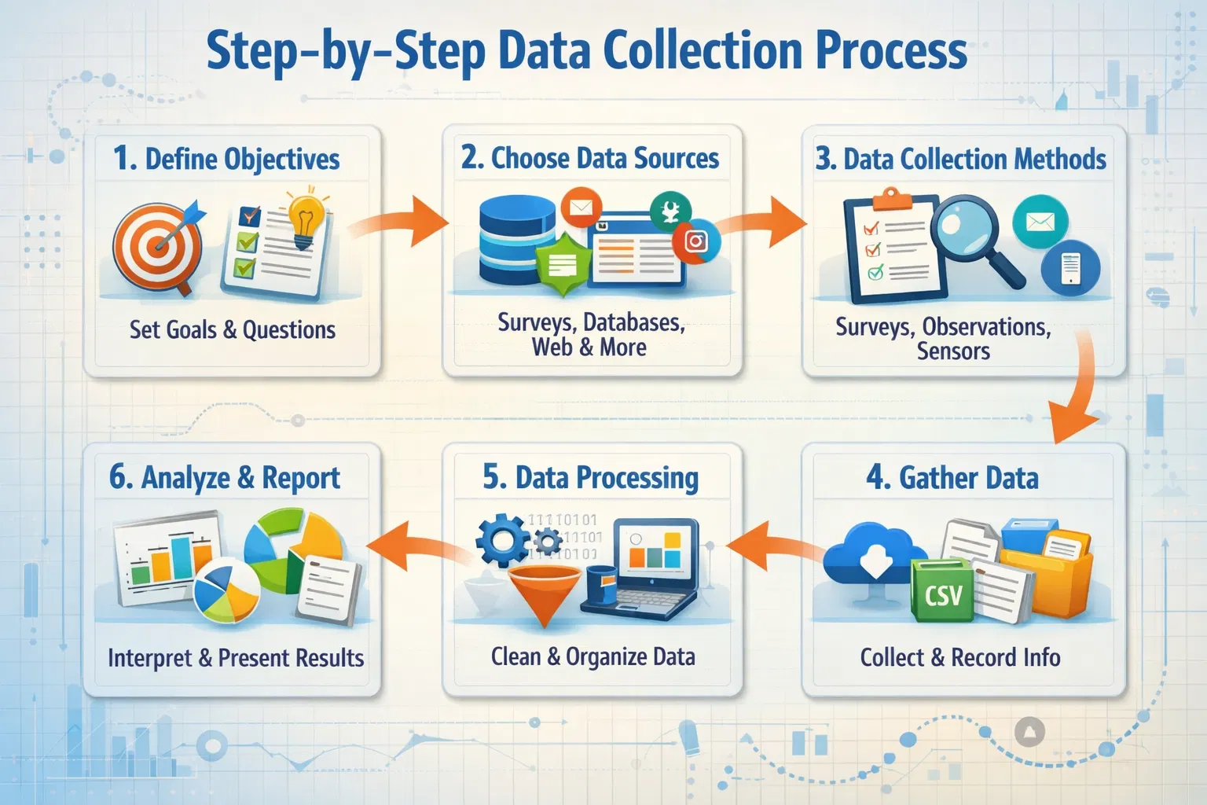
Data Collection Process

Slide 27
Data collection tools
Data collection tools are software or platforms used to gather and manage data easily,
such as Google Forms, SurveyMonkey, ODK, Qualtrics, Excel, and Power BI, which help collect, store, and analyze data efficiently.

Slide 28
What is Data Lifecycle Management (DLM)?
Data Lifecycle Management (DLM) is a policy-based approach of best practices to oversee the flow of an information system's data through its lifecycle, from creation to deletion. It includes stages such as storage, backup, archiving, and disposal and is employed by organizations that manage sensitive, private data subject to regulatory compliance.

Slide 29
Key stages of data lifecycle management
Data collection: Data is generated or gathered from sources like sensors, applications, surveys, transactions, or user inputs
Data Storage: The collected data is stored in databases, data warehouses, cloud storage, or local servers depending on its type and use
Data Processing: Raw data is cleaned, validated, organized, and transformed into a usable format for analysis.
Data Usage / Analysis: Processed data is used for decision-making, reporting, business intelligence, machine learning, or operational tasks.

Slide 30
DLM vs ILM
You might be wondering if this data lifecycle management is the same as information lifecycle management.
The primary distinction between Data Lifecycle Management (DLM) and Information Lifecycle Management (ILM) is that DLM concentrates on the management of entire files of data or records in the lifecycle, while the ILM approach takes into account the value of information to an organization rather than just considering it as raw data.
Both DLM and ILM play crucial roles in data management, with DLM determining when data is no longer useful and ILM regulating the accuracy and storage of data.
Simply, DLM focuses on managing raw data throughout its lifecycle, while ILM takes a more holistic approach by considering the value of information to an organization.

Slide 31
Benefits of DLM Implementation
Improved data access
Enhanced data access is critical in business, as it facilitates organizations to make informed decisions and enhance efficiency, productivity, and customer satisfaction.
Compliance with regulation
Deploying a DLM system can help organizations achieve compliance with regulations by providing an organized approach to data management, guaranteeing that data is acquired, stored, and processed in accordance with applicable laws and regulations.
Controlled data governance
Controlled data governance results in improved data quality, reduced data management costs, and increased access to data for all stakeholders.

Slide 32
What Is Data Integrity & Data Quality?
Data integrity
An organization usually starts by setting out processes, rules, and standards that control how data is gathered, stored, accessed, changed, and used. This is done to ensure a high level of data integrity.
Data quality
Data errors inevitably happen, even to the best of us. This is why we need data quality dimensions and metrics. These parameters help us to understand the utility and efficacy of a dataset, including its correctness, completeness, consistency, validity, uniqueness, and timeliness.

Slide 33
What is more important data integrity or data quality?
Data integrity and data quality are both critical parts of data management, and they’re closely linked to each other. Overall, the importance of data integrity vs. data quality depends on the context and use case.
For example, data integrity may play a more important role in scenarios where you need data for vital operations, financial transactions, medical records, or legal processes. It’s critical to ensure the accuracy and security of data to avoid potential issues or legal concerns caused by compromised data.
When data is used for analytical purposes, business intelligence, or decision-making, data quality becomes more important. To derive useful insights and make informed decisions, accurate, full, and relevant data is required.
In truth, both of these concepts are inextricably linked and equally important to an organization’s success. Focusing on them is beneficial because data integrity and quality contribute to a trustworthy data environment that efficiently supports diverse business tasks.

Slide 34
Benefits
Good Data Integrity
Greater speed with which data may be recovered in the case of a breach or unplanned outage
Keeping unauthorized access and data tampering at bay
Achieving and maintaining compliance more efficiently
Better decision making
Improved efficiency
Cost savings
Higher customer satisfaction

Slide 35
3.Introduction to Business Analyst Role

Slide 36
Introduction
A Business Analyst (BA) helps organizations improve business processes and solve problems. They connect business teams and technical teams. They use data and analysis to support decision-making.
Common BA Tools
Microsoft Excel
Tableau

Slide 37
Business Analyst Roles and Responsibilities
Gathering Business Requirements
Defining the Problem and Solution Scope
Facilitating Communication Between Stakeholders
Creating and Managing Documentation
Performing Data Analysis
Supporting Solution Implementation and Testing
Tracking and Measuring Project Success

Slide 38
Difference Between Business Analysts And Business Analytics Professionals?
Business Analyst
Business analysis has less to do with data and instead focuses on analyzing and optimizing the processes and functions that make up a business. They analyze what a business needs to function optimally and what it needs to improve, and then work to implement solutions. This may include improving processes, changing policies or introducing new technology.
Business Analytics Professional
Business analytics focuses on data, statistical analysis and reporting to help investigate and analyze business performance, provide insights, and drive recommendations to improve performance.
They may also work with internal or external clients, but their focus is to improve the product, marketing or customer experience by using insights from data, rather than analyzing processes and functions.

Slide 39
Core Business Analytics Skills
A good communicator
Being able to present findings in a clear and concise manner is fundamental to making sure that all players understand insights and can put recommendations into practice.
A problem solver
Professionals in analytics use a combination of logical thinking, predictive analytics and statistics to make recommendations that will solve problems and propel a business forward.
A critical thinker
Business analytics professionals need to think critically about not only the implications of the data they collect, but about what data they should be collecting in the first place.

Slide 40
Technical Skills for Business Analytics
SQL
SQL is the coding language of databases and one of the most important tools in an analytics professional’s toolkit. Professionals write SQL queries to extract and analyze data from the transactions database and develop visualizations to present to stakeholders.
Statistical languages
The two most common programming languages in analytics are R, for statistical analysis, and Python, for general programming. Knowledge in either of these languages can be beneficial when analyzing big data sets, but is not vital.
Statistical software
While the ability to program is helpful for a career in analytics, being able to write code isn’t necessarily required to work as an analytics professional. Apart from the above languages, statistical software such as SPSS, SAS, Sage, Mathematica, and even Excel can be used when managing and analyzing data.

Slide 41
The Four Types of Analytics
Descriptive Analytics Explains what happened by analyzing past data. Example: Monthly sales reports.
Diagnostic Analytics Explains why something happened by finding causes and patterns. Example: Finding why sales dropped in a specific month.
Predictive Analytics Predicts future outcomes using historical data and trends. Example: Forecasting future sales or customer demand.
Prescriptive Analytics Suggests the best actions to take for better results. Example: Recommending marketing strategies to increase sales.

Slide 42
Benefits of Business Analysts
Improve business efficiency
Support better decisions
Reduce operational problems
Improve communication
Help organizations grow

Slide 43
What is Waterfall & Agile Methodology
Waterfall Methodology
Linear and sequential approach
Each phase is completed before the next phase begins
Focuses on planning and documentation
Best for projects with fixed requirements
Easy to track progress and deadlines
Agile Methodology
Flexible and iterative approach
Work is divided into small cycles called sprints
Continuous testing and feedback
Encourages teamwork and collaboration
Quickly adapts to changes

Slide 44
Differences Between Waterfall And Agile
Agile Methodology
Flexible and iterative approach
Work is completed in small cycles called sprints
Changes can be made easily during development
Continuous customer feedback is included
Waterfall Methodology
Linear and sequential approach
Each phase must be completed before the next begins
Difficult to make changes after development starts
Limited customer involvement during the process

Slide 45
Examples
Technical projects: Agile provides teams with an organized approach to developing complex software or products. Multiple teams can collaborate orderly, without a 45-person planning or re-planning meeting.
Creative projects: Projects that involve a lot of creative problem-solving benefit from an agile approach as it allows for more experimentation and innovative thinking.
Startups: They often need to deliver products or services with limited resources quickly. Agile methods allow them to develop and implement ideas more rapidly, allowing for rapid prototyping and iteration on the fly.

Slide 46
What is Stakeholder Management?
Stakeholder management is the process of identifying, analyzing, and engaging people or groups affected by a project or business.
It helps organizations build good relationships and improve communication with stakeholders.
Effective stakeholder management supports project success and better decision-making.

Slide 47
Stakeholder Management Process
Identify stakeholders
Analyze stakeholders
Prioritize stakeholders
Develop communication plans
Engage and monitor stakeholders

Slide 48
What Isn’t Stakeholder Management?
Only communication It is more than just sending updates or emails.
Controlling people It focuses on collaboration, not forcing decisions.
A one-time activity Stakeholder management is a continuous process throughout a project.
Ignoring stakeholder needs Good management involves understanding and addressing concerns.
Only the manager’s responsibility Team members also help maintain stakeholder relationships.

Slide 49
Benefits of Stakeholder Management
Better teamwork and collaboration
Improved project planning
Faster problem solving
Increased stakeholder support
Better organizational reputation
Reduced project failure risks

Slide 50
Challenges in Stakeholder Management
Communication gaps
Conflicts of interest
Changing stakeholder expectations
Managing multiple stakeholders
Resistance to change

Slide 51
4.Data vs. Information (2 units)

Slide 52
Introduction
Raw Data
Raw data is the original data collected from different sources. It is unorganized and not analyzed. Raw data may contain errors, duplicates, or unnecessary information. It needs processing before use.
Processed Data
Processed data is organized and analyzed data.
It is converted into meaningful information.
Data cleaning, filtering, and analysis are done before use.
Easier to understand and use for decision-making.

Slide 53
The Importance of Processing Data
Enhancing Data Quality: Processing helps identify and correct errors, ensuring the accuracy of the data used for analysis.
Improving Efficiency: Cleaned and organized data allows for faster analysis and reporting, saving time and resources.
Facilitating Decision-Making: Processed data provides actionable insights that inform strategic decisions, enabling organizations to respond effectively to trends and changes.
Compliance and Reporting: Many industries require the use of processed data for compliance and regulatory reporting purposes.

Slide 54
Raw Data vs Processed Data
Raw Data
Original and unorganized
Difficult to analyze
Contains errors and duplicates
Needs processing
Processed Data
Organized and meaningful
Easy to analyze
More accurate and useful
Ready for reporting and decisions

Slide 55
Importance of Knowledge Management
Organizations collect huge amounts of information every day.
Raw information becomes valuable only when it is organized and used properly.
Knowledge helps businesses make better decisions and improve performance.
Information management improves access, sharing, and understanding of data
Improves business efficiency
Supports better decision-making
Enhances collaboration and communication
Helps employees access the right information quickly
Supports digital transformation and innovation

Slide 56
Steps to Transform Information into Knowledge
Focus on important business processes
Create common business language
Integrate information into systems and tools
Develop governance and management processes
Improve information organization and quality

Slide 57
Benefits
Faster access to information
Better collaboration among teams
Improved customer service
Better decision-making and productivity
Increased business agility and innovation

Slide 58
Challenges
Large amount of unstructured data
Poor information organization
Lack of governance and standards
Difficulty integrating systems
Maintaining updated and accurate content

Slide 59
The Importance of Information for Decision Making
Risk Management:
Informed decisions allow for better risk assessment and management. Decision-makers can anticipate potential challenges and implement strategies to mitigate risks.
Market Analysis:
Accurate and timely information about market trends, consumer preferences, and competitor actions is essential for firms to make informed decisions about pricing, production, and marketing strategies.
Policy Formulation:
Governments rely on information to formulate effective economic policies. Data on unemployment rates, inflation, and GDP growth are crucial for designing policies that promote economic stability.

Slide 60
Challenges in Information Gathering
Information Costs:
Gathering and processing information incur costs, and decision-makers need to weigh these costs against the benefits of having more accurate and timely information.
Incomplete Information:
In some cases, decision-makers may face incomplete information, making it challenging to make optimal choices. This is particularly relevant in dynamic and uncertain environments.

Slide 61
The Significance of Asymmetric Information
Market Failure:
Asymmetric information can lead to market failure, where the allocation of resources is not efficient. This is particularly evident in markets like insurance, where one party may have more information about their risk profile.
Adverse Selection:
Adverse selection occurs when individuals with private information about their risks are more likely to participate in certain transactions. This can lead to undesirable outcomes, such as higher premiums for insurance.
Moral Hazard:
Moral hazard arises when one party changes their behavior after entering into an agreement because the other party cannot observe or monitor the actions. This is common in situations involving insurance or financial transactions.

Slide 62
Mitigating Asymmetric Information
Screening and Signaling:
Screening involves mechanisms to separate high-risk from low-risk individuals. Signaling involves conveying private information to the other party to reduce information asymmetry.
Regulation and Disclosure:
Government regulations and disclosure requirements aim to ensure that relevant information is made available to all parties involved in transactions, reducing the impact of information asymmetry.

Slide 63
5.Overview of Data-Driven Decision Making

Slide 64
Introduction
Data-driven decision making (DDDM) means using data, facts, and analysis to make business decisions.
Organizations use data to improve performance, solve problems, and achieve business goals.
Data helps reduce uncertainty and supports better planning.
Modern businesses rely on data for faster and smarter decision-making.

Slide 65
Importance of Data-Driven Decision Making
Improves business performance
Supports accurate decision-making
Helps understand customer behavior
Reduces risks and uncertainty
Improves planning and forecasting
Increases productivity and efficiency

Slide 66
Common Data Sources
Customer feedback
Sales and transaction records
Social media data
Website analytics
Market research
Financial reports

Slide 67
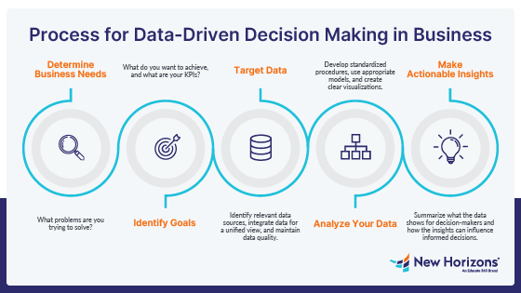
Transitioning to Data-Driven Decision-Making

Slide 68
Data Quality and Integrity
Establish a Data Governance Committee: Form a dedicated team responsible for setting data standards, policies, and procedures to ensure data integrity across the organization.
Develop Data Quality Metrics: Define specific, measurable indicators of data quality, such as accuracy, completeness, consistency, and timeliness, to monitor .
Implement Automated Data Monitoring Tools: Utilize software solutions that automatically monitor data for errors, anomalies, or inconsistencies, alerting teams to issues in real time.
Regular Data Cleansing: Schedule periodic cleaning of data to remove or correct inaccuracies, duplicates, and irrelevant information, keeping the data sets current and useful.

Slide 69
Technology's Role in Data-Driven Decisions
The Impact of AI and Machine Learning
Imagine the power to sift through extensive data sets effortlessly, uncovering intricate patterns, trends, and correlations previously hidden. This capability is now a tangible reality thanks to the advancements in artificial intelligence (AI) and machine learning (ML).

Slide 70
Why make data-driven decisions
Data-driven decision making is superior to other forms of decision making because it ensures that decisions are based on logic and reasoning as well as supported by numerical evidence. Without the use of data to inform decisions, decision makers run the risk of being subconsciously influenced by factors such as bias, external stimuli such as the opinions/demands of others, or acting on assumptions, gut-feeling or theory.

Slide 71
Five Steps for Implementing Data-Driven Decision Making
Determine Business Questions or Issues
The first step in effective DDDM is to determine the appropriate questions you want to answer or issues you want to solve with data. Begin by discussing the following with your team:
What does the company want to accomplish?
Is the company trying to assess an opportunity or diagnose a problem?
Which areas are most important to achieving the company's overall strategy?

Slide 72
Strategize and Identify Goals
Based on the questions or issues you've identified, establish a clear analytical objective for your DDDM process. Consider the following:
What can you realistically accomplish with data?
Who will oversee the collection and data analysis?
What personnel will you need for the project?
Target Data
Once you identify the strategic goals of your project, it's time to identify the data that will be most useful for you in this DDDM process. Consider the following questions in deciding which data to collect and how to do so:
Will qualitative or quantitative data be most useful to this project?
Is it feasible to convene focus groups to collect data?

Slide 73
Collect and Analyze Data
Now that you know the type of data you will target in this DDDM process, you need to identify the correct processes and personnel to gather and manage the data. Consider the following:
Does your company already have some of the data it needs in-house?
Will you need to purchase access to an existing data set?
Make Decisions Regarding Findings
The last step in the DDDM process is, of course, to make the data-driven decision. Leaders and other key decision makers can use the analytical insights gained from the process to take actionable steps needed for the success of a project.

Slide 74
What Positions Utilize Data-Driven Decision Making?
Data Analyst: As their title suggests, data analysts process large amounts of data to glean important findings that can guide impactful decisions. Data analysts also maintain databases, use visualization to communicate their findings and forecast trends based on their collected data.
Data Engineer: Data engineers work with businesses to build stable, optimized systems that aid in the collection and analysis of data. Professionals in this role also conduct research and look for patterns in data to help forecast trends.
Database Administrator: Database administrators are responsible for keeping data safe and correctly stored. People who work as database administrators manage data, implement security measures and often design the databases themselves.

Slide 75
Benefits
Faster decision-making
Better customer understanding
Improved productivity
Better resource management
Competitive advantage
Increased profitability

Slide 76
Challenges
Poor data quality
Data security and privacy risks
Large amount of data
Lack of technical skills
Difficulty integrating different data sources

Slide 77
8 Pitfalls In The Data-Driven Decision-Making (DDDM) Process
Poor Data Quality
Incorrect or incomplete data can lead to wrong decisions. Duplicate, outdated, or inaccurate data reduces reliability. Organizations must clean and validate data regularly.
Too Much Data
Large amounts of data can create confusion. Important insights may be difficult to identify. Businesses should focus only on relevant and useful data.
Ignoring Business Goals
Collecting data without clear goals wastes time and resources. Data analysis should support business objectives and strategies. Organizations need clear questions before analyzing data.

Slide 78
Bias in Data
Biased data can produce unfair or inaccurate results. Personal opinions or incomplete datasets may affect analysis. Organizations should ensure balanced and unbiased data collection.
Misinterpreting Data
Incorrect analysis can lead to poor business decisions. Data should be understood in the correct context.
Lack of Data Skills
Employees may not have enough knowledge to analyze data properly. Organizations should provide training and develop data literacy. Skilled professionals improve data-driven decision-making.
Ignoring Human Judgment
Data is important, but human experience and intuition also matter. Businesses should combine analytics with expert judgment. Balanced decision-making improves outcomes.
Slow Decision-Making
Spending too much time analyzing data can delay actions. Businesses need timely insights for faster responses. Quick and effective decisions improve competitiveness.

Slide 79
6.Case Discussions / Real-Life Examples

Slide 80
What Is Scenario Analysis?
Scenario analysis forecasts the future value of a portfolio by simulating changes in key factors like interest rates. Investors use it to understand how portfolios respond to different events, including worst-case scenarios. This technique applies mathematical and statistical principles to prepare for both likely and unlikely financial outcomes.

Slide 81
Steps to Conduct Effective Scenario Analysis
Calculate different reinvestment rates for expected returns within the investment horizon.
Apply mathematical and statistical principles to estimate shifts in portfolio value.
Assess the risk level based on different scenarios and determine if it aligns with your comfort zone.

Slide 82
Difference Between Scenario Analysis and Sensitivity Analysis
Scenario Analysis
Scenario analysis examines the effect of changing multiple variables at the same time to create different possible situations or scenarios.
Used to study best-case, worst-case, and most likely situations
Helps in strategic planning and decision-making
Sensitivity Analysis
Sensitivity analysis studies how changing one variable at a time affects the final result while keeping other variables constant.
Used to identify which variable has the biggest impact
Helps understand uncertainty and key risk factors

Slide 83
Advantages
Better preparation for future events
Improved decision-making
Helps identify opportunities and threats
Encourages flexible planning
Supports long-term business growth

Slide 84
Limitations
Time-consuming process
Depends on assumptions and estimates
Difficult to predict all future events
Requires accurate data and analysis
May become complex for large organizations

Slide 85
7.Introduction to Data Governance & Data Ethics

Slide 86
Introduction
Organizations generate large amounts of data every day.
Proper management of data is important for security, accuracy, and business decisions.
Data governance helps organizations control and manage their data effectively.
It ensures data is reliable, secure, and properly used.

Slide 87
Why modern data governance is critical for AI
The shift toward AI data analytics has made unified governance a business imperative. Content that bridges the gap between traditional analytics and generative AI. Without robust governance, AI initiatives face several risks:
Data silos: Information trapped in isolated systems prevents the creation of a unified data lake house
Poor data quality: Inaccurate data leads to "hallucinations" in AI agents and unreliable business insights
Data permissions: Agents can access sensitive data that can show up as outputs to personas without proper credentials
Compliance gaps: Failure to handle data according to regulations like GDPR or CCPA can stall AI deployments

Slide 88
What is data governance used for?
Data stewardship
Data governance often means giving accountability and responsibility for both the data itself and the processes that ensure its proper use to “data stewards.”
Data quality
Data governance is also used to ensure data quality, which refers to any activities or techniques designed to make sure data is suitable to be used.
Data management
This is a broad concept encompassing all aspects of managing data as an enterprise asset, from collection and storage

Slide 89
Benefits of Data Governance
Better decision-making
Improved data accuracy
Increased operational efficiency
Better compliance with regulations
Reduced risks and security issues
Improved customer trust

Slide 90
Challenges in Data Governance
Managing large volumes of data
Poor data quality
Lack of clear policies
Data privacy concerns
Integration of data from different systems

Slide 91
4 Critical Roles In Data Governance
Data administrator: The data admin is the individual that oversees the implementation of an entire data governance program. If there is any data-related conflict, the data administrator is the escalation point to resolve the conflict.
Data steward: The data steward enables access to quality data for users across an organization. They bring together business and IT as a core function to enable critical data at accessible access points.
Data custodian: The data custodian focuses on data in transit, as well as at storage points. Their job includes looking at the movement of data, storage of it, as well as security and use across the organization.
Data user: The data user is any individual within an organization that makes use of accessible data to bring value forward.

Slide 92
How does data governance work?
Organize and maintain high‑quality data at scale
As data grows, it’s crucial to locate, organize, and govern it across databases, data warehouses, and data lakes.
Discover and understand data in context
Security and IT teams should understand not just where data is stored, but its context and meaning.
Balance privacy, access, and protection
Protecting data is to balance privacy, access, and security.
Control risk and meet compliance requirements
Strong data governance includes knowing who has access to data and how it’s used, allowing businesses to reduce risk and maintain compliance.

Slide 93
Data Governance Checklist
Define roles and responsibilities: Set up data governance roles, involve stakeholders, and ensure accountability.
Establish policies and standards: Define and document data governance policies, tagging, validation, and compliance guardrails.
Identify metrics and KPIs: Select KPIs linked to business outcomes and track performance continuously.
Build a single source of truth: Connect all data assets in a unified catalog with bidirectional metadata flow.
Outline access controls and user roles: Govern access using personas, user roles, and data domains through the catalog.

Slide 94
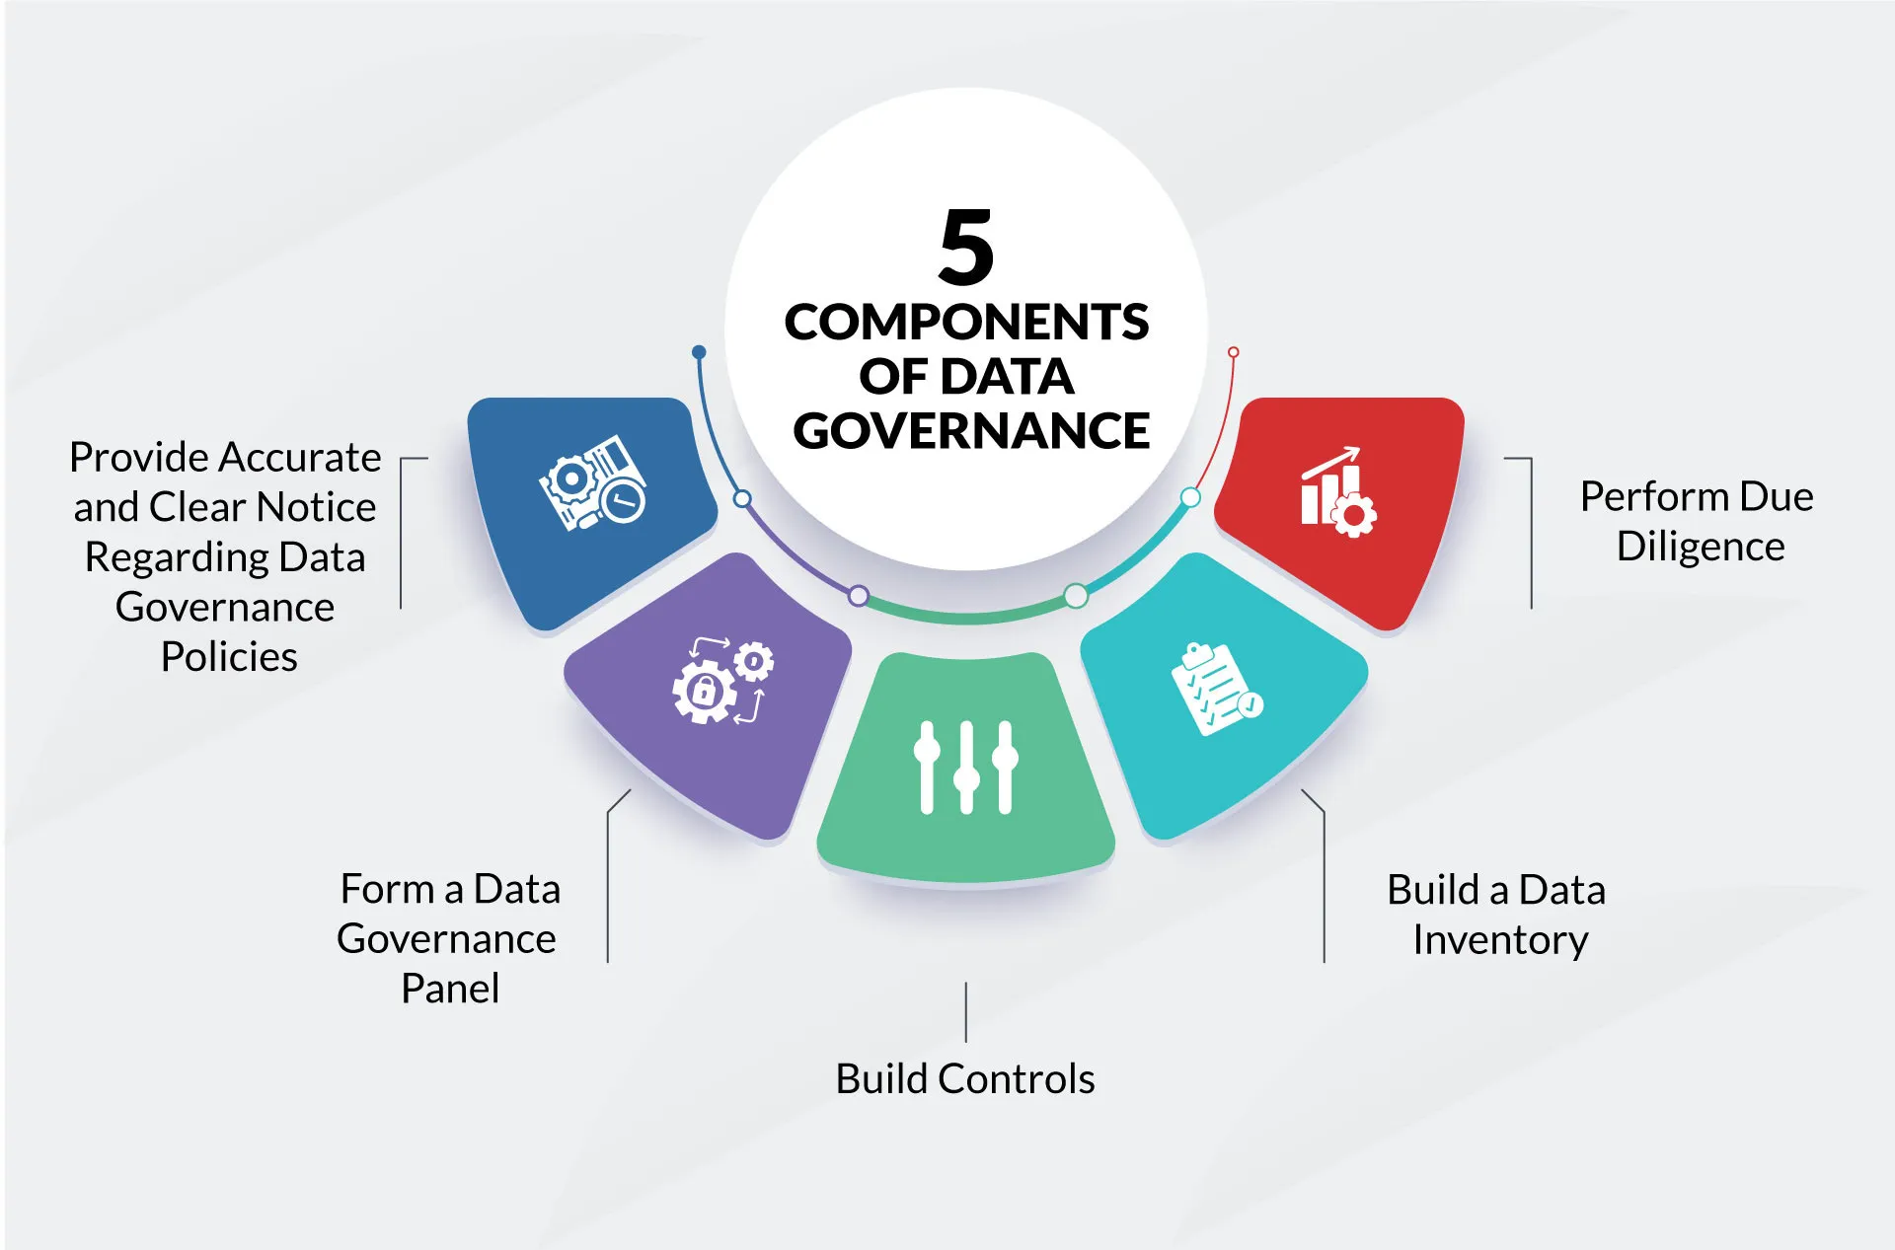
Provide accurate and clear notice regarding data governance policies

Slide 95
Benefits
Better decision-making
Improved operational efficiency
Increased data security
Better compliance management
Reduced business risks
Improved customer confidence

Slide 96
Challenges
Managing large volumes of data
Poor data quality
Lack of clear policies and standards
Data privacy and security risks
Integration of multiple data sources

Slide 97
Creating and Implementing a Comprehensive Data Governance Policy
Define the Purpose and Scope of the Policy: Clearly articulate the objectives and boundaries of the data governance policy to ensure alignment with organizational goals.
Establish a Data Governance Framework and Structure: Develop a framework that outlines the governance structure, including the roles and responsibilities of the data governance team and other key stakeholders.
Define Data Governance Principles and Standards: Establish guiding principles and standards for data management to ensure consistency and compliance across the organization.
Identify Roles and Responsibilities for Data Stewards and Other Stakeholders: Assign specific roles and responsibilities to data stewards and other stakeholders to ensure accountability and effective implementation of the policy.

Slide 98
Why Policies Are Important
Improve data quality and accuracy
Protect sensitive information
Ensure compliance with regulations
Support better decision-making
Reduce risks related to data misuse

Slide 99
Ensuring Compliance with Data Governance Policies
Collaborative Effort: Compliance is not the sole responsibility of a single team. Engaging multiple departments—including legal, IT, and operations—enables a more comprehensive approach to developing and enforcing data governance policies.
Training and Awareness: Educating employees on data governance policies, including roles and responsibilities, is essential for consistent compliance across the organization.
Regular Audits and Assessments: Implementing periodic audits to verify adherence to data governance policies and ensure data integrity reduces risks of non-compliance and data breaches.
Data Quality and Accuracy: Policies that prioritize data accuracy and quality help organizations maintain compliance while improving decision-making processes.

Slide 100
Benefits
Better data management
Improved business efficiency
Increased data security
Better compliance with regulations
Reduced operational risks
Improved decision-making

Slide 101
What is Data Ethics?
Data is collected and used by organizations every day.
Ethical use of data is important for protecting people and organizations.
Data ethics focuses on responsible collection, storage, and use of data.
It helps build trust, fairness, and transparency.

Slide 102
Why Data Ethics is Important
Protects personal privacy
Prevents misuse of data
Builds customer trust
Ensures fairness and transparency
Supports responsible decision-making
Helps organizations follow regulations

Slide 103
Principles of Big Data Ethics
Transparency: Clear communication about data collection, storage, and sharing practices is vital. Users should understand how their information is being used, without needing legal expertise to navigate terms and conditions.
Accountability: Organizations must take responsibility for the data they collect, including protecting it from breaches and misuse.
Individual Agency: Individuals should have control over their personal data, including the ability to access, correct, or delete their information. Ensuring this agency is a fundamental human right in the digital age.

Slide 104
Understanding the Current & Potential Future Data Ethics Landscape
Privacy Protection – Organizations must protect personal information from misuse and unauthorized access.
Transparency – Users should know what data is collected and how it is used.
Fairness and Bias Reduction – AI systems and algorithms should avoid discrimination and unfair decisions.
Accountability – Companies and governments must take responsibility for data-related decisions.
Security – Strong cybersecurity measures are needed to prevent data breaches.

Slide 105
Today’s Challenges
Ethical Algorithms
Algorithms have the potential to amplify the impact of any action a million times over as they’re implemented. Even in the infancy of their capability, there are many examples of how a lack of ethical safeguards for algorithms affects us.
Data Privacy
Learn more about data privacy and anonymization in Python with our interactive course.
Data Security
From inherent security flaws to hacking vulnerabilities, data security can put more than your login info at risk. Apps and websites of all kinds can pinpoint your location, read your messages, see who you’ve blocked, and how you spend.

Slide 106
Why Ethics Defines the Future of Web Data
Ethics plays a major role in shaping the future of web data because the internet collects, stores, and processes huge amounts of personal and business information every day. As technologies like artificial intelligence (AI), big data, and cloud computing grow rapidly, ethical data practices are becoming essential for maintaining trust, privacy, and fairness.

Slide 107
The Core Principles of Responsible Collection
Purpose clarity means you define why you’re collecting data before you start. Every crawl must serve a documented business goal such as price tracking, sentiment analysis, or competitive benchmarking.
Consent and rights come next. Many websites explicitly state how their content can be accessed. Checking the robots.txt file or Terms of Service is not optional; it’s a baseline courtesy.
Minimization keeps the collection lean. You don’t need to store every element on a page to answer your business question.
Transparency is about documentation. Record the source, schema, and update frequency. When your legal or compliance team asks for an audit trail, you’ll have one ready.
Protection completes the loop. Store data securely, encrypt it at rest and in transit, restrict access, and delete it when it’s no longer useful.

Slide 108
How does data ethics impact AI and machine learning?
Data ethics significantly impacts AI and machine learning as these technologies rely heavily on data. Ethical considerations include ensuring fairness, avoiding biases, and protecting privacy. Organizations must carefully consider how data is used to train AI models and ensure that these models do not perpetuate discrimination or harm. Ethical AI development involves continuous monitoring, testing for biases, and involving diverse stakeholders in the design process.

Slide 109
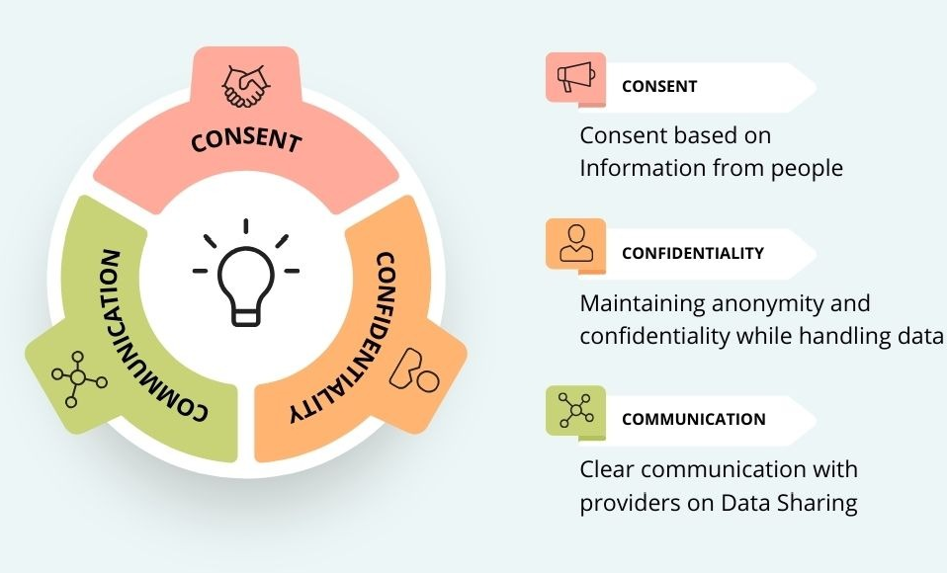
Top 3 Ethics in Data Collection

Slide 110
Benefits
Improves customer trust and loyalty
Enhances business reputation
Reduces legal and security risks
Supports accurate and reliable analysis
Encourages responsible innovation

Slide 111
What is California Consumer Privacy Act (CCPA)
The CCPA is a California state data privacy law that gives California residents specific rights over their personal information — including the right to know, access, delete, and opt out of its sale. It applies to any business that collects or processes the data of California residents, regardless of where the business is located.
The CCPA imposes rules on businesses the “covered entities” that handle sensitive information. It also grants consumers new privacy rights and protections. The CCPA enhances consumer privacy rights in several ways:
CCPA Requires greater transparency.
CCPA gives consumers broad access to their personal information.

Slide 112
What is General Data Protection Regulation (GDPR)
The GDPR is a European Union data protection law that regulates how organizations collect, process, and store the personal data of individuals in the EU and EEA. It emphasizes consent, transparency, and accountability to protect individual privacy rights.
The GDPR became effective in May 2018 across the 27 member states of the European Union.
GDPR dictates how businesses, through their website and mobile applications, should handle customer information. Attributes like name, email ID, location, data from wearables, IP address, and more are categorized as personal information under GDPR.

Slide 113
Differences Between CCPA and GDPR
GDPR
GDPR stands for General Data Protection Regulation.
It is a privacy law of the European Union (EU).
GDPR focuses strongly on data protection and user consent.
It applies to any organization handling data of EU citizens.
CCPA
CCPA stands for California Consumer Privacy Act.
It is a privacy law of California, USA.
CCPA focuses more on consumer privacy and transparency.
It applies to businesses collecting data of California residents.

Slide 114
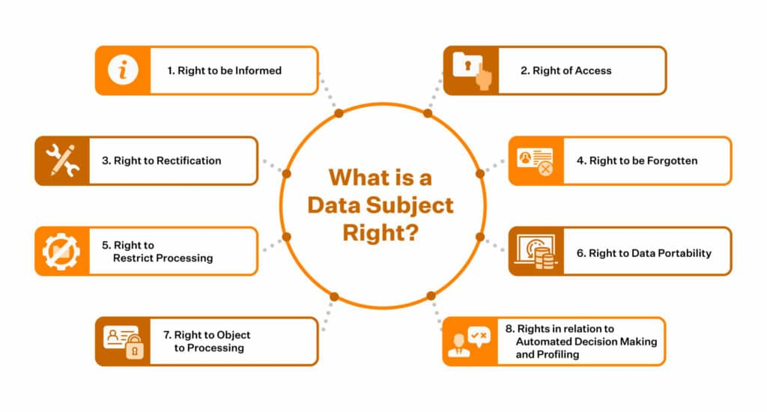
Information Shared with Data Subjects

Slide 115
Understanding the Importance of Responsible Data Practices
Builds customer trust and loyalty
Protects sensitive information
Improves data quality and decision-making
Reduces risks of data breaches
Supports legal and regulatory compliance

Slide 116
The Role of Technology in Responsible Data Practices
Data Security: Technologies like encryption, firewalls, and multi-factor authentication protect sensitive information from cyber threats.
Privacy Protection: Tools such as data masking and anonymization help keep personal information confidential.
Access Control: Role-based access systems ensure that only authorized users can access specific data.
Data Quality Management: Automated tools help maintain accurate, complete, and consistent data.

Slide 117
Challenges in Implementing Responsible Data Practices
Managing large amounts of data
Maintaining privacy and security
Employee resistance to change
Rapidly changing regulations
Ethical concerns in AI and analytics

Slide 118
THANK YOU

